Slide 1



Junk Food Marketing

Slide 2
Learning objectives
To understand what food marketing is
To understand the impact of junk food advertising
To learn about advertising tricks and hacks
To learn about what we can do
Notes:
Learning objectives

Slide 3
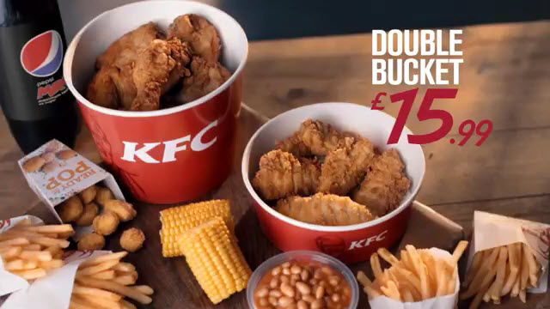
Notes:
Ask the children: Put your hand up if you have seen an image like this before? Where have you seen it? Ask children to note down all the places they have seen similar advertisements (e.g TV, online, on their phone, billboards, bus ticket, bus stop etc).

Slide 4
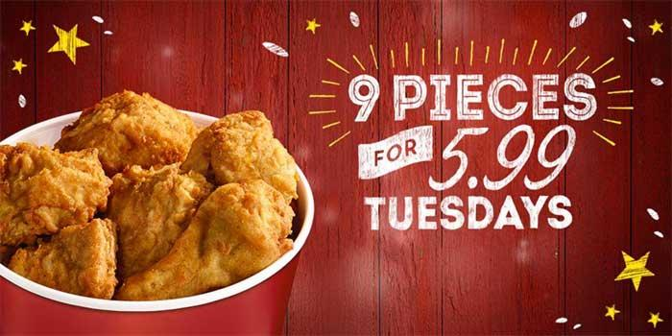
What is the point of advertising?
Notes:
Ask children: We have all seem images like this before – junk food adverts for popular fast food chains like McDonalds, KFC, Burger King
But what is the point of these advertisements? Why are we seeing these images constantly on our phones, our TV’s, on our journey to school or work? (prompt for answers such as ‘to make us buy the product, to make us want to have/eat it etc’)

Slide 5
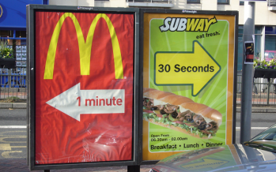
Repeat exposure
Notes:
This repeat exposure to these fast food adverts make us hyper aware of these brands and encourages our preferences and purchases. If you’re hungry and see an advert that says the nearest Subway is 30 seconds away, you’re likely to be tempted to go there aren’t you?
Ask children: How many times a day do you think you see fast food adverts? (prompt with numbers, once, three times, five times?)
On average, teenagers are exposed to 12 advertisements an hour whilst watching TV shows like the Voice, X Factor or Hollyoaks. This is just on TV and not considering all the other ways in which we see advertisements like we discussed earlier.
https://www.theguardian.com/society/2017/nov/28/children-seeing-up-to-12-adverts-for-junk-food-an-hour-on-tv-study-finds

Slide 6
Billboards
TV and online
Train stations
Bus tickets
Shopping centres
Notes:
Now let’s go back to the places you noted down, did you write down any of these?

Slide 7
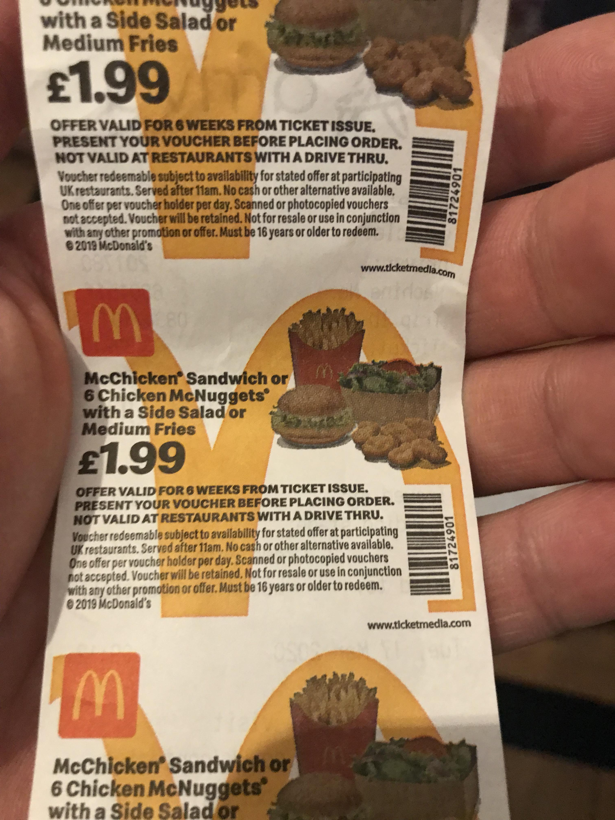
McDonald’s meal deal on the back of a bus ticket
Notes:
A lot of fast food adverts are on TV and online, but have you ever noticed a McDonald’s meal deal on the back of your bus ticket…?

Slide 8
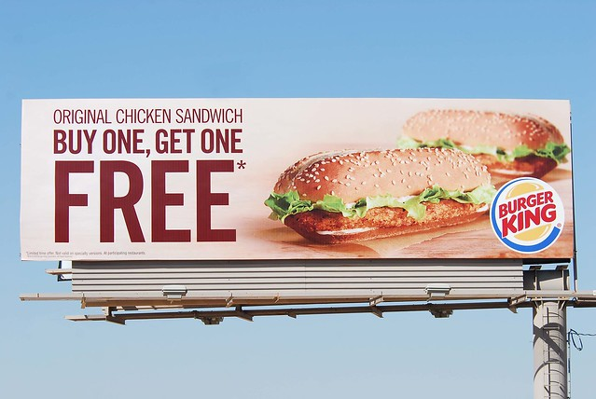
Burger King billboard advert over a motorway
Notes:
How about a massive billboard for Burger King whilst you’re walking down the street?

Slide 9
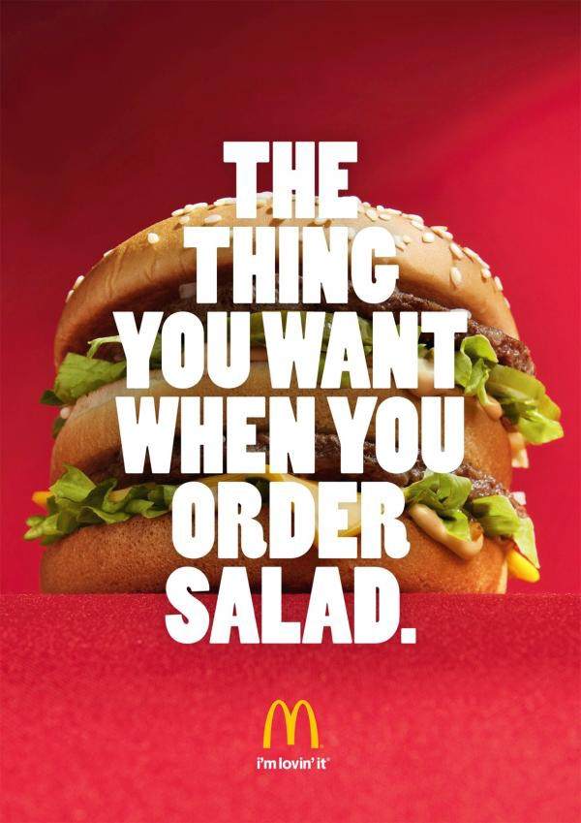
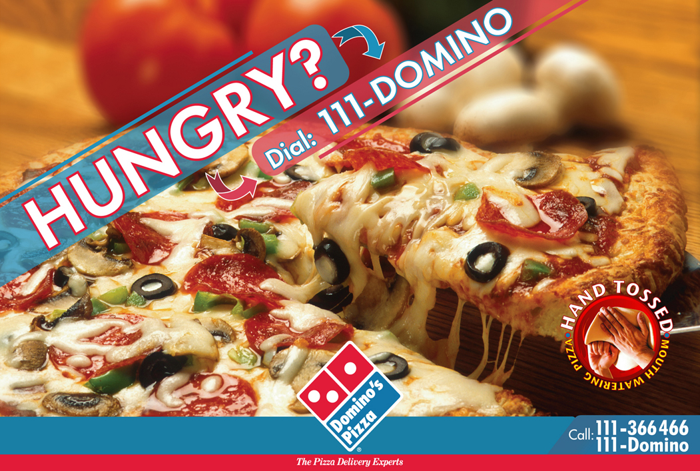
Food companies at fault
Notes:
These companies want you to constantly buy their products so they can keep making money. Top junk food brands spend millions of pounds every year on advertising.
They hire a team of researchers to find out the most effective way of advertising their products to you – say a KFC burger, a McDonald’s milkshake or a Domino’s pizza
They make an advert to make the product seem irresistible … but is it always what it seems?
https://www.bmj.com/content/359/bmj.j4677?hwoasp=authn%3A1593726964%3A203%3A35390022%3A0%3A0%3AKyei9fzRVwARUFNYaDuj5w%3D%3D

Slide 10
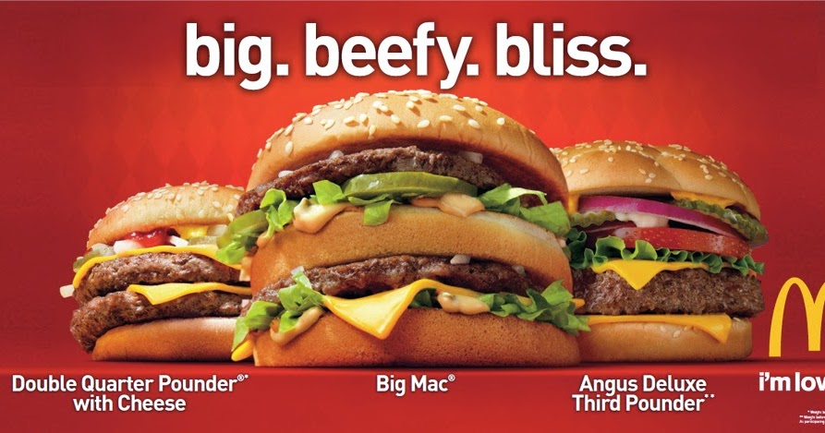
Why is it so effective?
Notes:
Have you ever thought how adverts make foods look so appealing and colourful…? Is this really what a McDonald’s burger looks like when you buy it…?

Slide 11
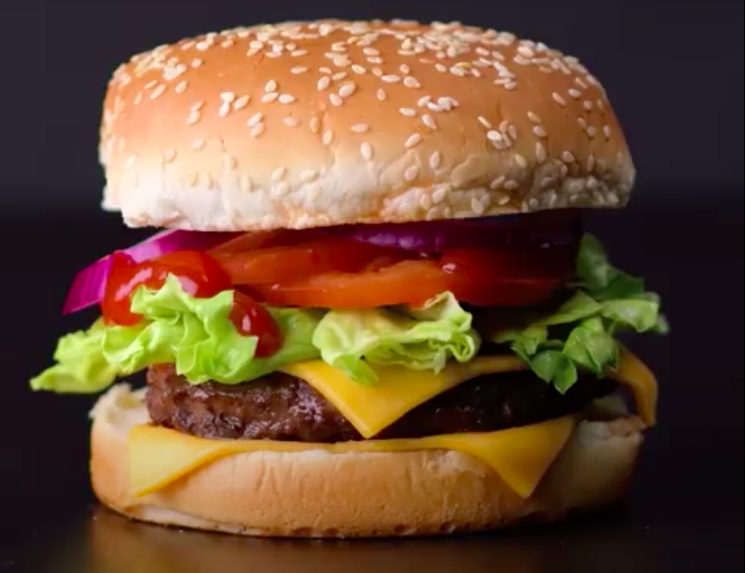
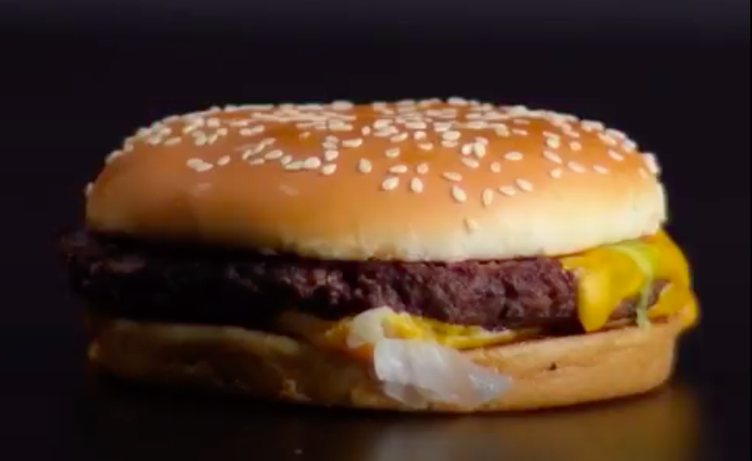
Trick or treat?
Notes:
Advertising tricks!
Ask children: Two pictures of a burger, but which picture would you see in an advert? Left or right? Can you pick out the differences? (Turn to person next to you and say three differences between these images)

Slide 12
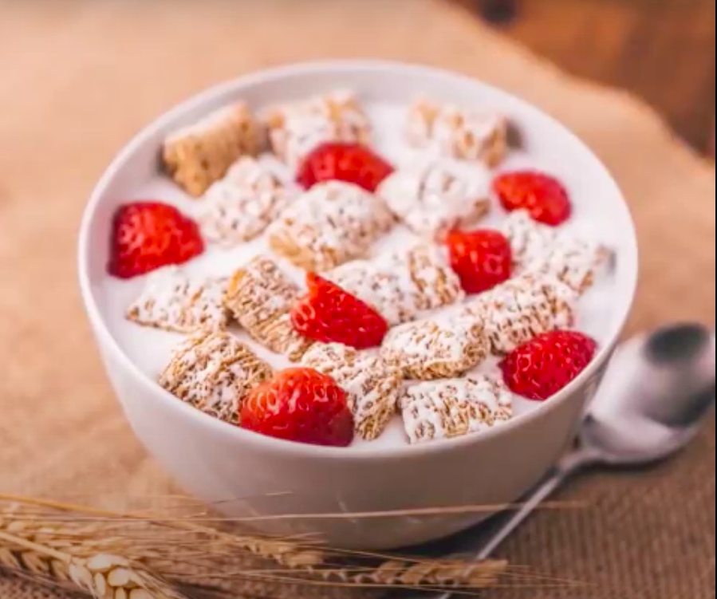
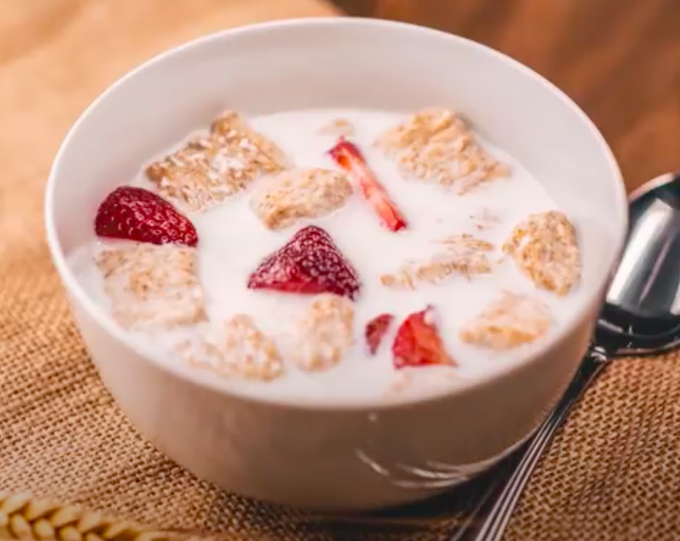
Trick or treat?
Notes:
Advertising tricks!
How about this one? What are the differences?

Slide 13
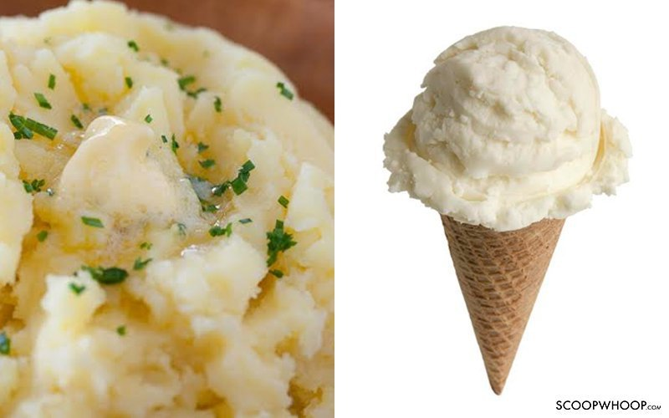
Trick or treat?
Notes:
Potato or ice cream…?

Slide 14
Play advertising tricks video (2 min max)
Trick or treat?
Notes:
Advertising tricks!
https://www.youtube.com/watch?v=MflT0I7ZPCs
Play 2 mins of video showing how advertisers trick customers.
Ask children if they had any idea how food adverts are made?
As we can see from the video, advertisers use all sorts of tricks and hacks to create an irresistible product that we would want to buy, but when you see how it’s made, it doesn’t look very appetising does it?
Glue is used for milk, mashed potato is used to create ice cream (which would otherwise melt under the hot camera lights!) and pins and pieces of cardboard are used to build a burger to make it look bigger.

Slide 15
What is the impact?
Advertisers want you to eat these foods all the time
Fast food is high in fat, sugar and salt and contains empty calories – meaning there is no nutritional value in the food
If consumed a lot they can increase our risk of developing heart disease, diabetes and obesity
Notes:
Advertisers want you to buy and eat these foods all the time…but what would happen if we did?
Fast food is high in fat, sugar and salt and contains empty calories – which means there is no nutritional value in the food
If these foods are consumed a lot they can increase our risk of developing heart disease, diabetes and obesity

Slide 16
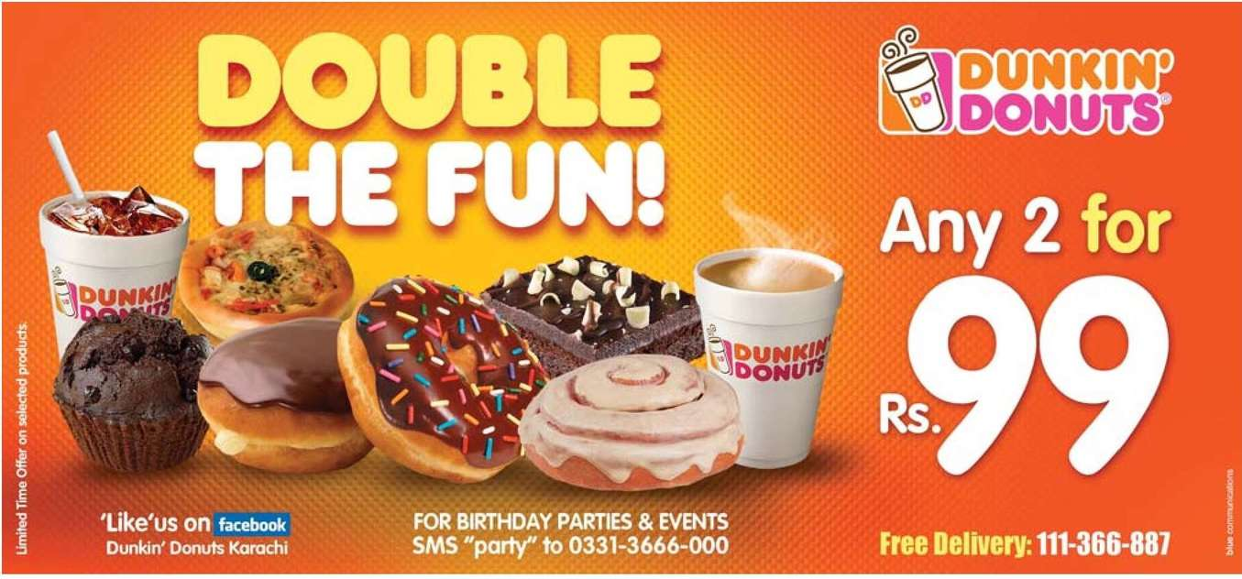
Is this really fun…?
Notes:
These foods are fine to eat in moderation. The problem is we are constantly bombarded with adverts for these products, usually with discount offers like the one above. Have you ever seen lots of adverts for fruits or vegetables…?
Ask children if they have seen food adverts with discounts on them before/if it tempts them to buy it

Slide 17
What can we do?
Only eat junk food every once in a while
Try to recognise fast food advertising and be aware of it’s motives
Write to local MP

Slide 18
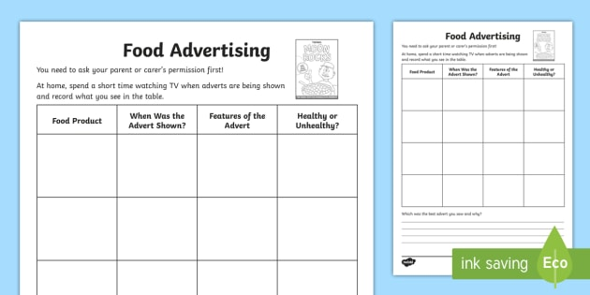
Activity
Notes:
‘How many adverts can you spot’ worksheet - write how many, where you saw it, and what the advert was.
Design an advert for a ‘healthy’ food in groups of two/threes
Quiz

Slide 19
What is food marketing?
List three places you are likely to see fast food adverts
In an advert, what is used to make ice-cream look real?
What can happen if we eat too much fast food?
Write down one thing you have learnt form this presentation.
Recap Quiz
Notes:
Recap quiz

Slide 20


