Slide 1



Sugar and Health
Notes:
Introduce the session and make introductions
Remind pupils if they have a question they need to raise their hand

Slide 2
What we will learn today
To learn about why we shouldn’t eat and drink too much sugar
To find out which types of foods contain a lot of sugar and which do not
To talk about how we can make simple tasty swaps to reduce how much sugar we eat and drink
Notes:
Read out the learning objectives from the slide

Slide 3
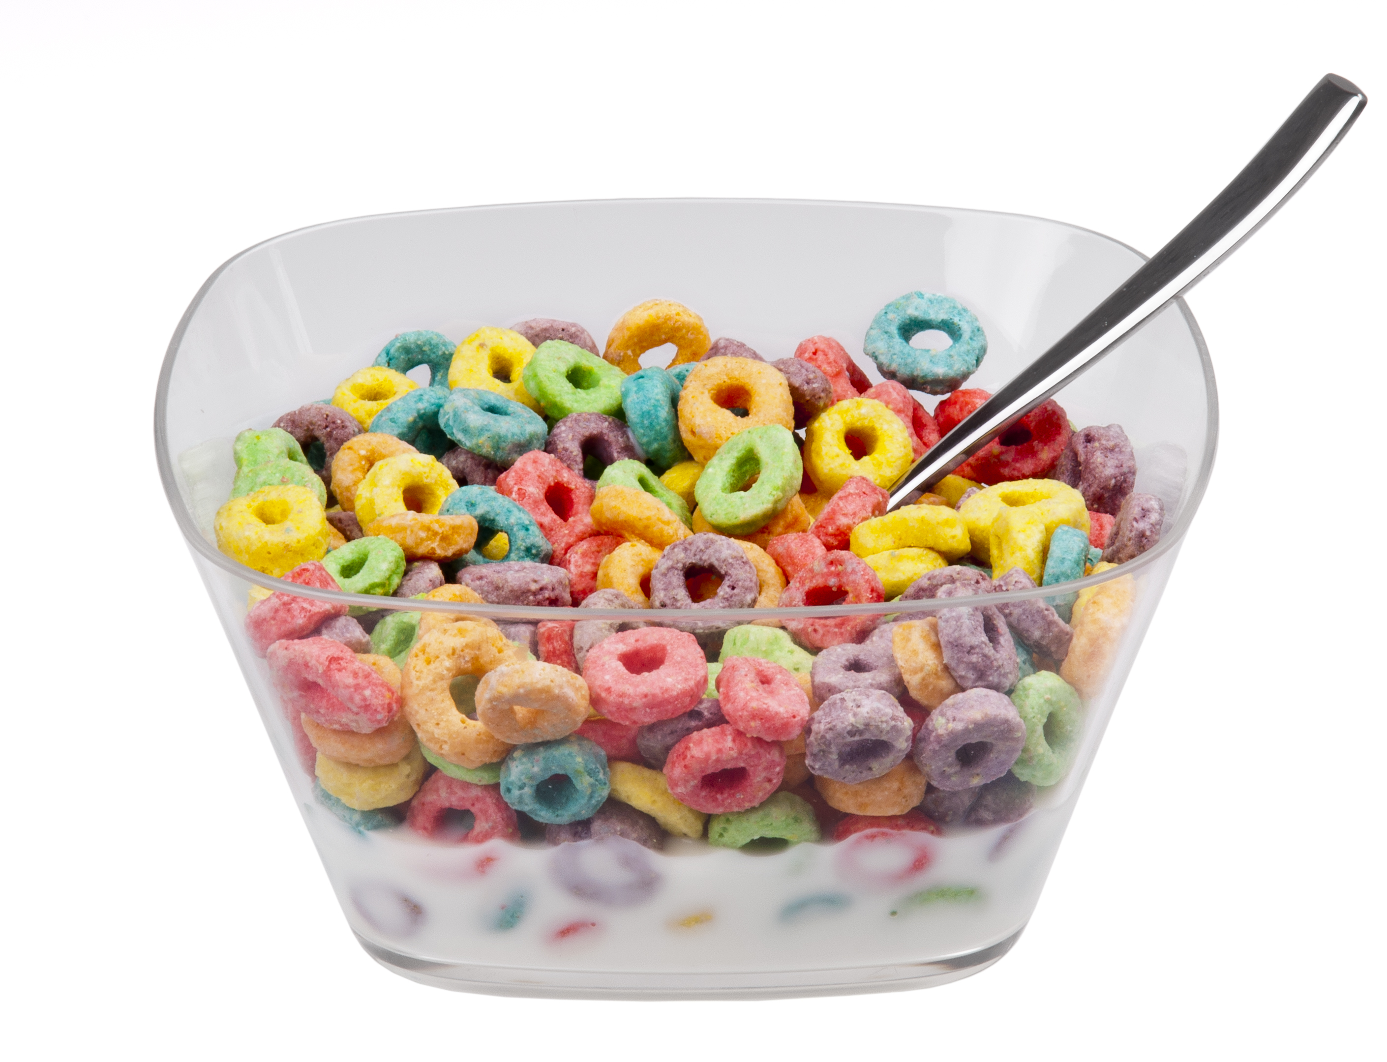
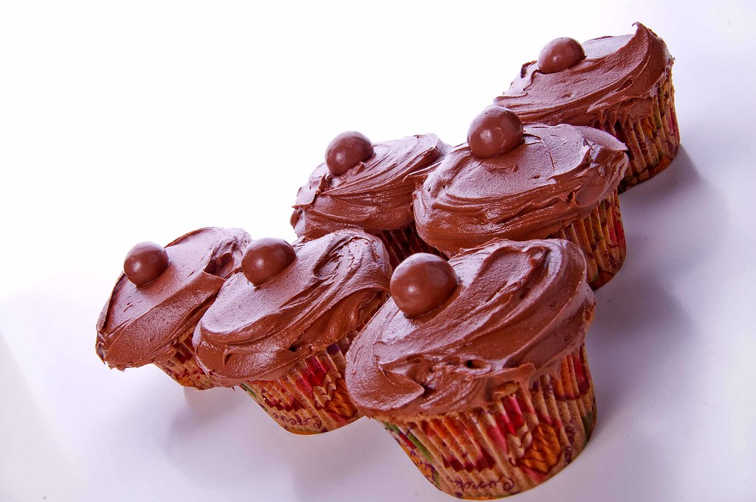
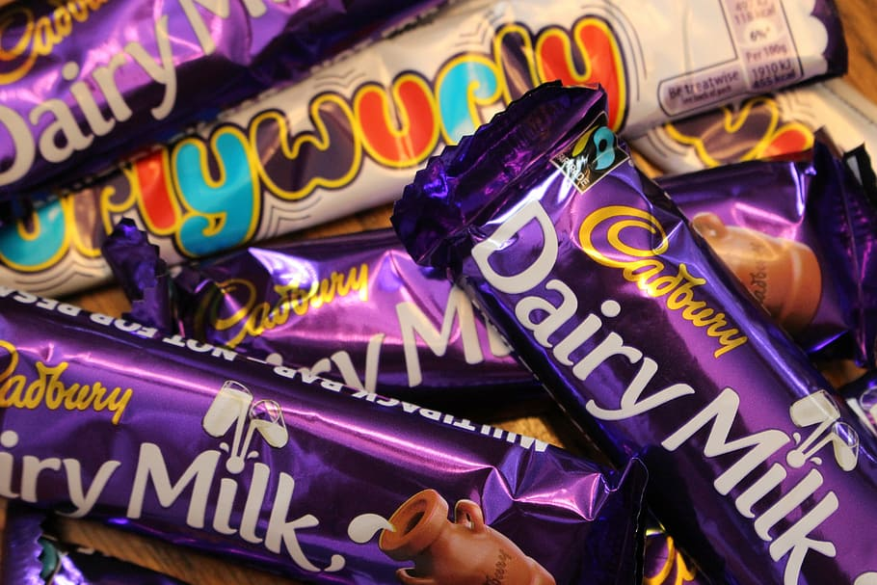
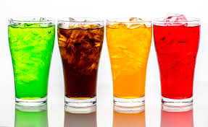
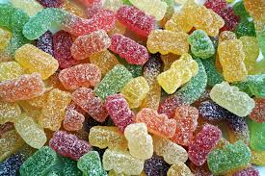
Which foods are HIGH in sugar?
Notes:
Ask the children if they can think of any foods that are sugary.
Answers could include: chocolate bars, sweets, cakes, biscuits, Coca Cola, cereals.
One by one, reveal the images (animations will reveal when clicked)
Ask the children if there are any foods/drinks here that they eat regularly.

Slide 4
TRUE?
False?
Notes:
Tell the children you are now going to play a game of True or False.
Explain that a selection of different types of food and drink will be displayed – if they think it contains sugar, stand up.
If they don’t think it contains sugar, stay sat down.

Slide 5
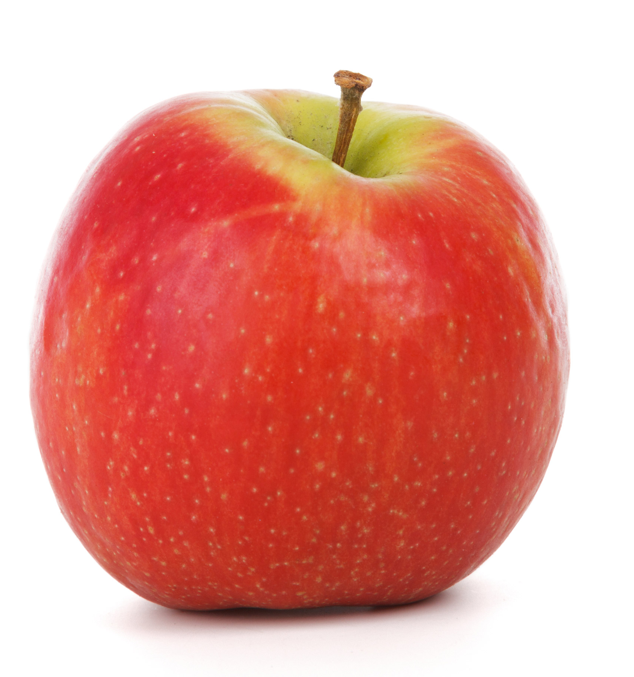
Sugar is also found in…
DID YOU KNOW?
Natural sugars are found in fruit. We don’t need to worry about these types of sugars
TRUE?
FALSE?
Notes:
Ask the children ‘who thinks there is sugar in an apple?’
Answer: True
Explain that whilst fruit contains sugar, these are natural sugars so we don’t need to worry about them. Fruit is very healthy and a great snack.

Slide 6
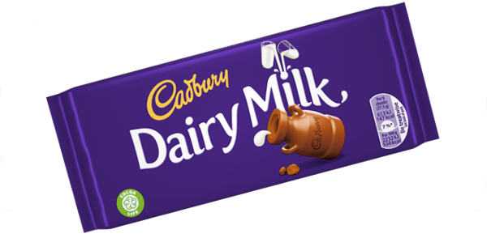
Sugar is also found in…
DID YOU KNOW?
Chocolate bars are very high in sugar – this Cadbury dairy milk bar contains 25g of sugar!
TRUE?
FALSE?
Notes:
Ask the pupils ‘who thinks there is sugar in a chocolate bar?’
Answer: True
Ask the pupils who remain sat down if they are surprised
Explain that all chocolate bars contain a high amount of sugar and should be eaten in moderation.

Slide 7
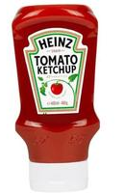
Sugar is also found in…
DID YOU KNOW?
Some of our favourite sauces and condiments can be high in sugar.
TRUE?
FALSE?
Notes:
Ask the children ‘who thinks there is sugar in tomato ketchup?’
Answer: True
Ask the children who remain sat down if they are surprised
Ask the children who likes tomato ketchup and what they have it with
Explain that sauces like tomato ketchup and salad cream can be high in sugar, so try not to have too much!

Slide 8
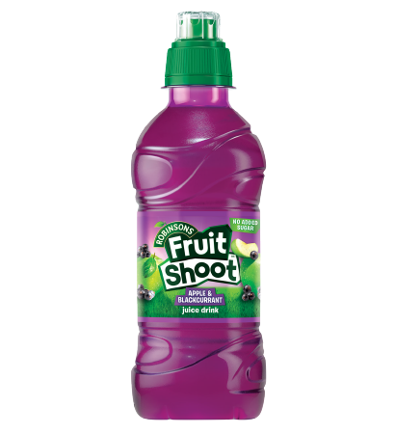
Sugar is also found in…
DID YOU KNOW?
Fruit shoot has reduced it’s sugar content in recent years meaning it is a healthier choice – but water and low fat milk are best for our teeth.
TRUE?
FALSE?
Notes:
Ask the children who likes fruit shoot and why
Ask the children ‘who thinks there is sugar in fruit shoot?’
Answer: True
Ask the children who remain sat down if they are surprised and why.
Explain that fruit shoots have much less sugar than they used to so a healthier choice compared to other sugary drinks – but water and milk are the best choices for a healthy smile!

Slide 9
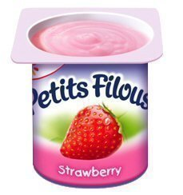
Sugar is also found in…
DID YOU KNOW?
Don’t be fooled by the fruity packaging – flavoured yogurts contain lots of sugar. Plain yogurt topped with fruit is a better choice.
TRUE?
FALSE?
Notes:
Ask the children ‘who thinks there is sugar in fruity yogurts such as petits filous?’
Answer: True
Ask the children who remain sat down if they are surprised and why.
Explain that plain yogurt is a very healthy choice, but flavoured pots can be very high in sugar. Don’t be fooled by the fruity packaging!

Slide 10
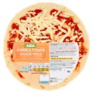
Sugar is also found in…
DID YOU KNOW?
Everyone loves a slice of pizza – but try to eat in moderation as even savoury foods like Pizza contain sugar!
TRUE?
FALSE?
Notes:
Ask the children who likes pizza and what their favourite toppings are
Ask the children ‘who thinks there is sugar in pizza?’
Answer: True
Ask the children who remain sat down if they are surprised and why.
Explain that whilst pizza is a tasty choice, certain toppings (such as tomato or barbeque sauce) can contain more sugar than you might think so try to eat in small amounts.

Slide 11
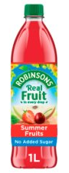
Sugar is also found in…
DID YOU KNOW?
Some soft drinks contain no added sugar which is great, but they also contain nasty acids which can damage our teeth. That’s why milk and water are best!
TRUE?
FALSE?
Notes:
Ask the children ‘who thinks there is sugar in squash?’
Answer: False
Explain that this squash says ‘no added sugar’ so is a low-sugar drink choice. Instead it uses things called sweeteners – these are ok in small amounts as they contain acids which can damage our teeth. That’s why milk and water are always the best option!
Note that not all squashes are sugar free, and to ask your parents to read the label to double check.

Slide 12

Notes:
Ask the children if they know why eating too much is a problem (answers are on the next slide)

Slide 13



What is the problem with sugar?
Sugary food and drinks might taste nice but eating them too often can cause problems such as:
Tooth decay
Can make it difficult for us to concentrate
Health problems as we get older
Notes:
Explain that whilst sugary food and drinks might taste nice, eating them too often can cause problems
These problems can include – list the items on the slide

Slide 14
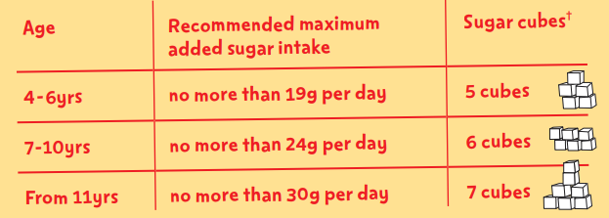
How much sugar are we allowed?
Notes:
Explain that because too much sugar is bad for us, there are some guidelines to help us limit the amount we eat.
Ask the children to tell you how many sugar cubes they are allowed every day.

Slide 15


What does 5 cubes of sugar look like?
Notes:
Explain that a Petits Filous yoghurt contains just over 9g of sugar
Explain that a Paw Patrol cupcake contains 11.6g of sugar
Tell the children that eating one yoghurt and one cupcake per day is just over 5 cubes of sugar (the recommended intake for 4-6 year olds)

Slide 16
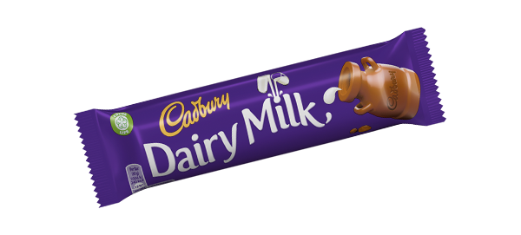
What does 6 cubes of sugar look like?
Notes:
Explain that there are 25g of sugar in a dairy milk bar, just over 6 cubes of sugar (recommended daily intake for 7-10 year olds).

Slide 17
  SUGAR SWAPS
Notes:
Now it’s time for some sugar swaps!

Slide 18
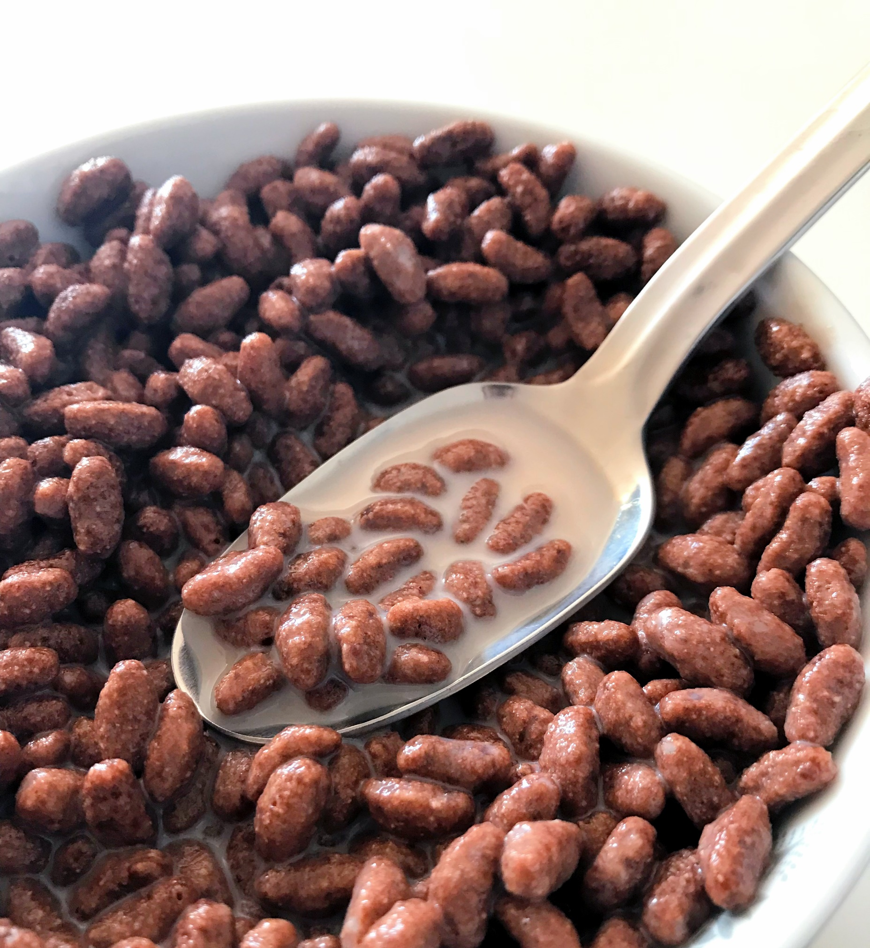
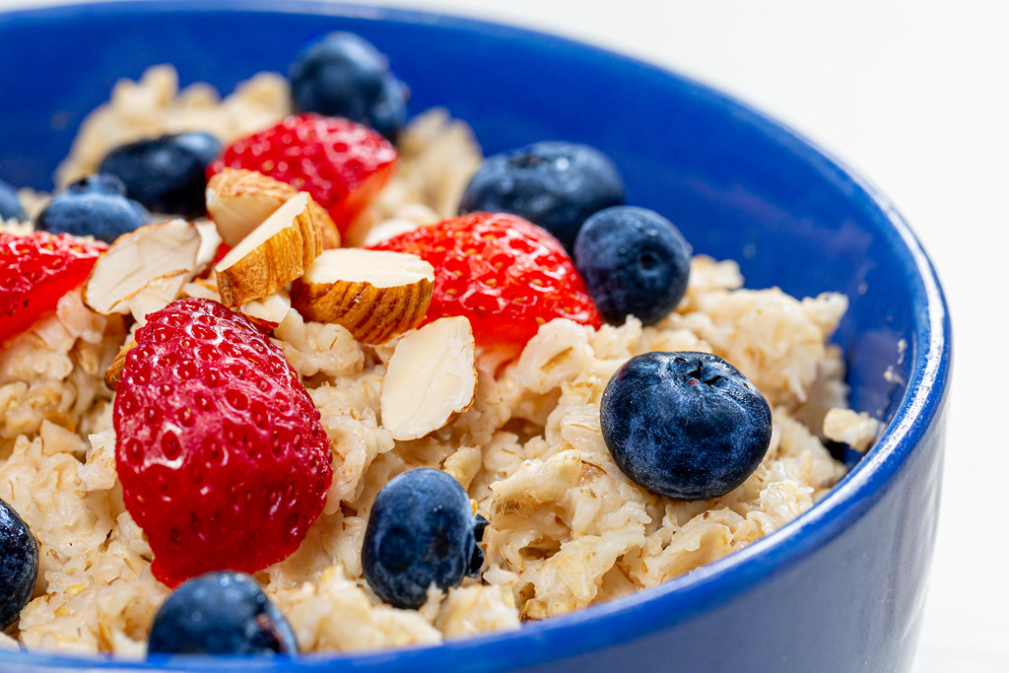

Breakfast swaps…
High sugar cereals
Low sugar cereals
Frosted flakes
Honey crunch cereal
Chocolate cereals
Plain porridge and fruit
Weetabix
Shredded wheat
Notes:
Explain to the children some cereals can be really high in sugar, so it’s important we chose lower sugar options to start the day right!
Before revealing the cereals, ask the pupils to put their hands up if they have cereal in the morning. Select 2-3 children to tell the group what cereals they often have.
Reveal the cereals, and explain that you can swap cereals like frosted flakes, honey crunch cereals and chocolate cereals for healthier options like porridge, Weetabix and shredded wheat.
Watch out for flavoured porridges – even the fruity ones!
As a quick recap, as the pupils why it’s important for our health to choose lower sugar cereals.

Slide 19
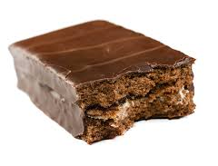
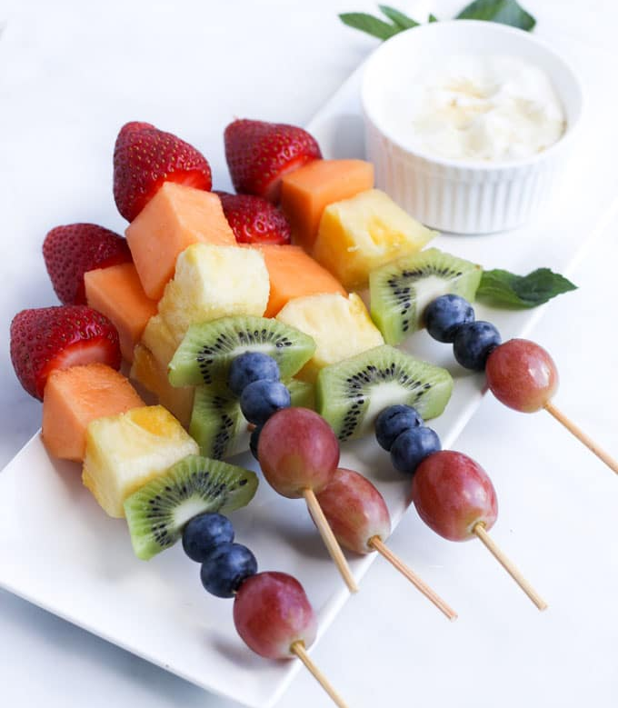
Snack swaps…
High sugar snacks
Low sugar snacks
Chocolate bars
Biscuits
Doughnuts
Muffins
Fruit skewers
Veg sticks & dip
Crumpet/toast
Raisins
Notes:
Explain to the children some snacks can be really high in sugar, so it’s important we chose lower sugar options where we can.
Before revealing the snacks, ask the pupils what their favourite snack is. Select 2-3 pupils to tell the group what snacks they often have.
Reveal the snacks, and explain that you can swap snacks like chocolate bars, biscuits, doughnuts and muffins for tasty fruit skewers, veg sticks and dip, a crumpet/slice of toast and raisins.
Explain that foods like chocolate, biscuits and cakes are often really high in sugar, so we should try our best to eat as little of these as possible. Why not save them until the weekend as a treat!

Slide 20
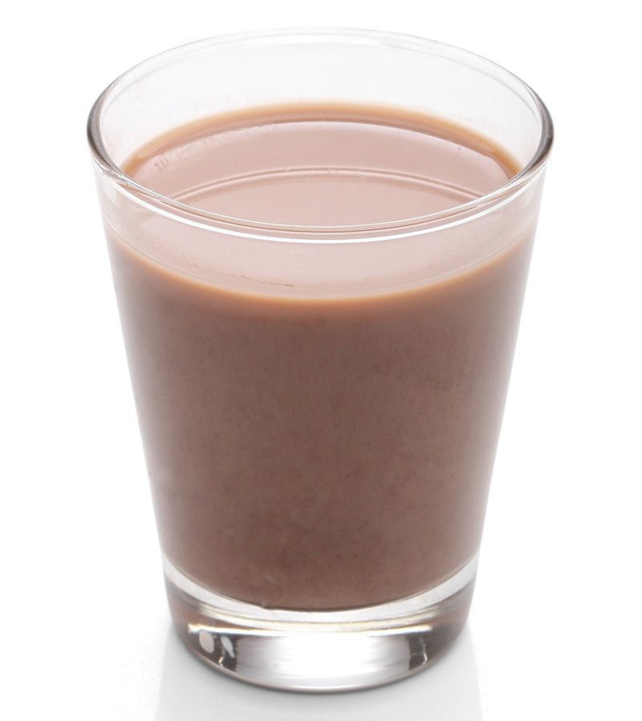

Drink swaps…
High sugar drinks
Low sugar drinks
Cola
Juice drinks
Milkshakes
Fizzy drinks
Water – it’s free!
Lower fat milk
Sugar-free drinks
No added sugar drinks
Notes:
Explain to the children some drinks can be really high in sugar, so it’s important we chose lower sugar options where we can.
Before revealing the drinks, ask the pupils what their favourite drinks is. Select 2-3 pupils to tell the group what drinks they often have.
Reveal the drinks, and explain that you can swap snacks like cola, juice drinks, milkshakes and fizzy drinks for water, lower fat milk, sugar free drinks or no added sugar drinks.
Explain that 100% fresh fruit juice can be a healthy choice – but only when consumed in small amounts as it is very high in sugar. Stick to no more than 150ml – which also counts as a portion of fruit!
Explain that although water may seem boring, it is the healthiest choice of drink for us. Try adding your favourite fruit to your glass or bottle of water to give it some healthy, fruity flavour!

Slide 21
RECAP
Notes:
RECAP: ask the pupils to write down one thing they have learnt today and one food or drink they regularly consume that they could swap for a healthier option on a post-it note.
After 2 minutes, ask the group if anyone wants to share their post it notes. Pick 2-3 pupils to share and speak in front of the rest of the group.

Slide 22
What we learnt today
Why we shouldn’t eat and drink too much sugar
Which types of foods contain a lot of sugar and which do not
How we can make simple tasty swaps to reduce how much sugar we eat and drink
Notes:
Read out the learning objectives from the slide

Slide 23
Thank you for listening!
Any questions?

